Slide 1
选择重传

Slide 2
Selective Repeat
receiver individually acknowledges all correctly received pkts
buffers pkts, as needed, for eventual in-order delivery to upper layer
sender only resends pkts for which ACK not received
sender timer for each unACKed pkt
sender window
N consecutive seq #’s
again limits seq #s of sent, unACKed pkts

Slide 3
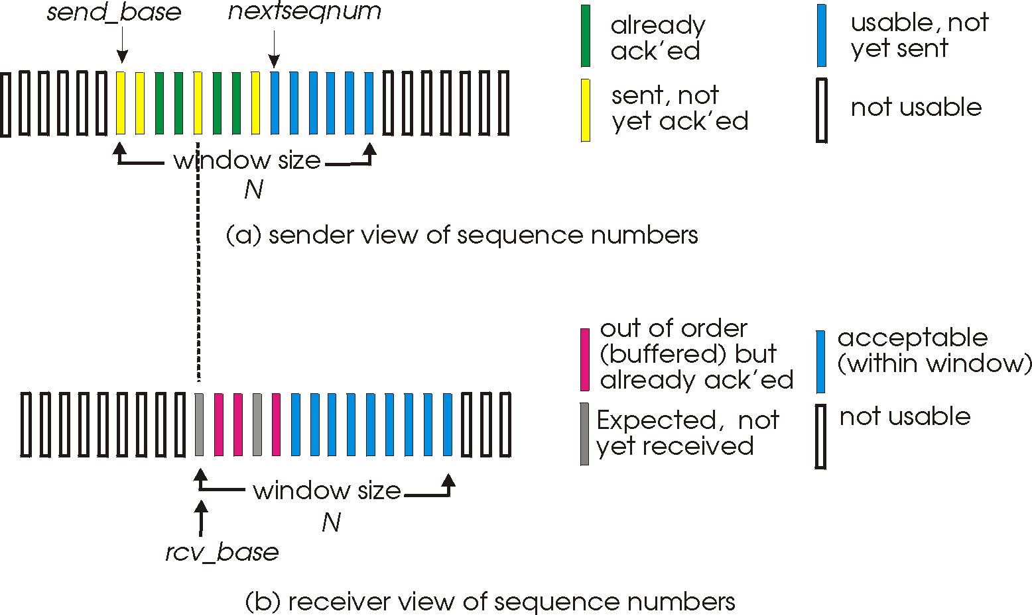
Selective repeat: sender, receiver windows

Slide 4
Selective repeat
sender
receiver
data from above:
if next available seq # in window, send pkt
timeout(n):
resend pkt n, restart timer
ACK(n) in [sendbase,sendbase+N]:
mark pkt n as received
if n smallest unACKed pkt, advance window base to next unACKed seq #
pkt n in [rcvbase, rcvbase+N-1]
send ACK(n)
out-of-order: buffer
in-order: deliver (also deliver buffered, in-order pkts), advance window to next not-yet-received pkt
pkt n in [rcvbase-N,rcvbase-1]
ACK(n)
otherwise:
ignore

Slide 5
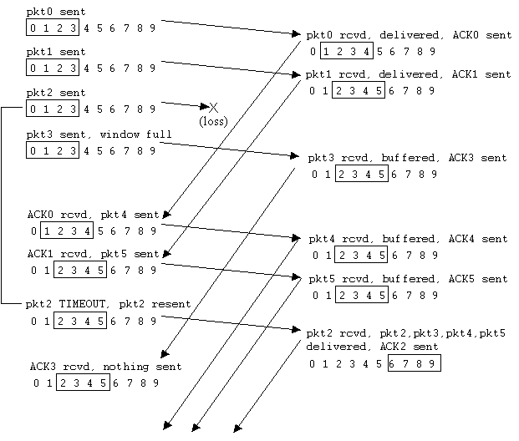
Selective repeat in action

Slide 6

Summary
What’s Selective Repeat

